Slide 1
Deep neural nets and sequence models
Deep neural nets, language models, RNNs, LSTMs

Slide 2
Exam details
Coming on Wednesday

Slide 3
Deep neural nets

Slide 4
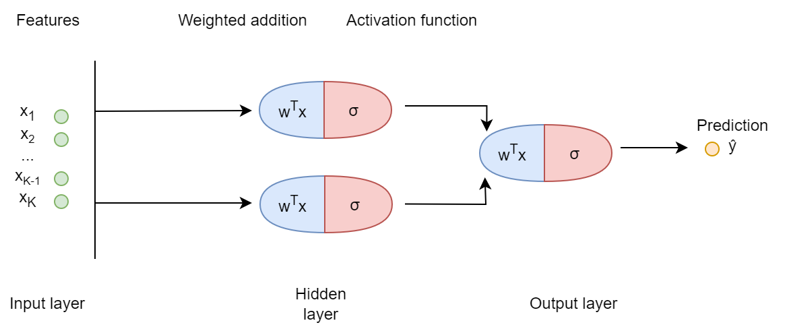
Notes:
Deep neural nets are "just" this: stacks of layers, where the output or "activation" from previous layer are the inputs for the next layer. For example, here we have three nodes in the first layer, that are doing logistic regression: linearly combining the features, and then applying a sigmoid function to them. This produces the output or activation of that node, which is one number per data point. Then, these two activations are fed into a second layer with one node, which again takes the activations (so two numbers per data point), combines them linearly, and feeds those through another activation function, which produces the outputs that we are actually interested in. As a result, what these first hidden layer nodes will learn is not to predict the output directly, but to provide relevant "summaries" of the features to the next layer, which is trying to make predictions.

Slide 5
Deep neural nets
This is just a stack of equations
Hidden layer:
Activation of node (1): a⁽¹⁾ = σ(w^{(1) T} x)
Activation of node (2): a⁽²⁾ = σ(w^{(2) T} x)
Output layer:
Activation: ŷ = σ( w₀⁽³⁾ + w₁⁽³⁾ a⁽¹⁾ + w₂⁽³⁾ a⁽²⁾ )

Slide 6
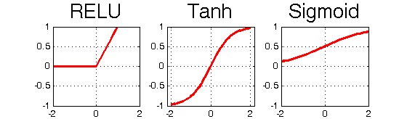
Deep neural nets
Alternative activation functions
ReLU
tanh
These work well for hidden layer units
The output layer of course must produce ŷ's on the right scale (e.g. 0-1)
Notes:
a.k.a. rectified linear unit and hyperbolic tangent function

Slide 7
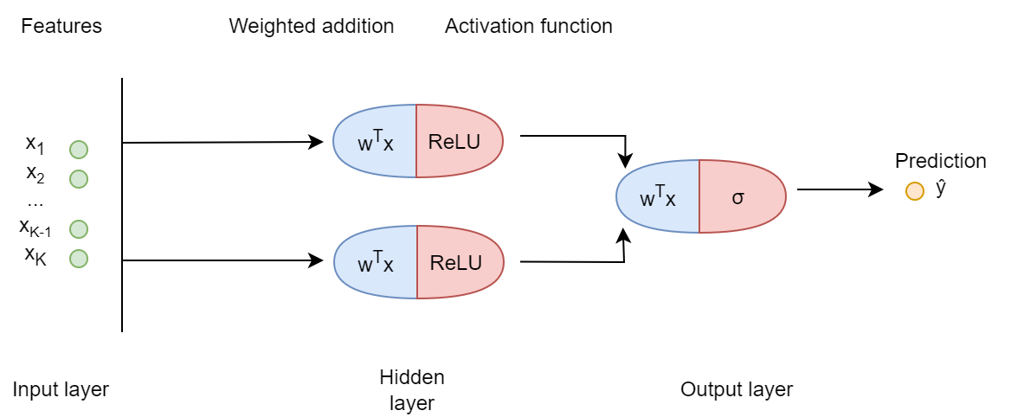

Slide 8
Deep neural nets
Why we need activation functions:
Stacking linear layers makes no sense

Slide 9

Notes:
Toy example:
One feature x
Hidden layer with two linear units
Output layer with one linear unit

Slide 10
Deep neural nets
One feature x, hidden layer with two linear units:
Activation of unit (1): a⁽¹⁾ = z₁ = w₀⁽¹⁾ + w₁⁽¹⁾ x
Activation of unit (2): a⁽²⁾ = z₂ = w₀⁽²⁾ + w₁⁽²⁾ x
Output layer with one linear unit:
Activation: ŷ = w₀⁽³⁾ + w₁⁽³⁾ a⁽¹⁾ + w₂⁽³⁾ a⁽²⁾ = (some intercept) + (some slope) x
Notes:
This is just OLS! It’s a linear function of x with an intercept and a slope. The fact that the intercept and slope look a little complicated, with two parameters in them, makes no difference. That only means that the model is underidentified, i.e. that there are many different solutions, because the parameters are in a way interchangeable. We can’t make any new shapes with this, the extra parameters don’t afford us anything. That’s why we need non-linear activation functions: because stacking linear layers doesn’t buy us anything.

Slide 11
Deep neural nets
Neural net regularization:
Loss function penalties (e.g. L1, L2)
Limited no. of nodes
Limited no. of layers
"Early stopping“ of gradient descent
Notes:
The second and third are hyperparameters of the neural net: variables that govern its complexity or flexibility.

Slide 12
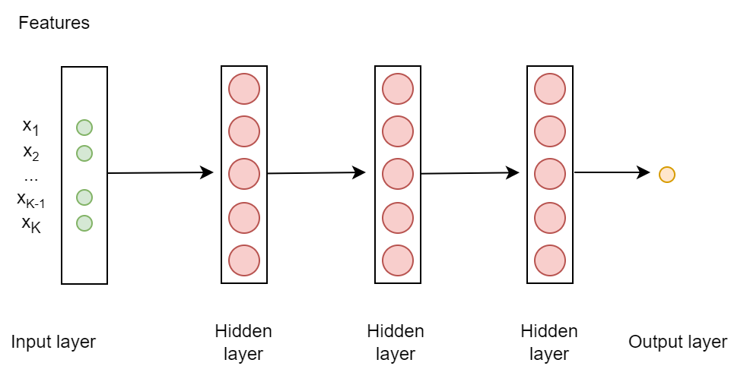
Notes:
Before we move on, just a note about notation. When we have neural nets with many nodes and many layers, we typically don’t draw out each node and each connection. Instead, we will have:
Boxes that symbolize one layer, typically with some nodes drawn into them, but not actually as many nodes are there are in the layer, because there are often dozens or hundreds;
Arrow that symbolize that every activation from the previous layer is fed into each node in the next layer. We also sometimes show this is a big X (draw on blackboard).
The idea is that we only want to show a bird’s eye view of the model architecture, without going into too much detail.

Slide 13
Language models

Slide 14
Language models
LM’s estimate the probability of some token(s) in some context
e.g. what is the next word in the sentence? “The cat is on the…”
e.g. did this word (“cat”) appear in the vicinity of another word (“mat”)?
e.g. what is the French translation of “the cat”?

Slide 15
Language models
LM’s are often self-supervised
= no annotation, correct label is already present in the data
e.g. what is the next word in the sentence?

Slide 16
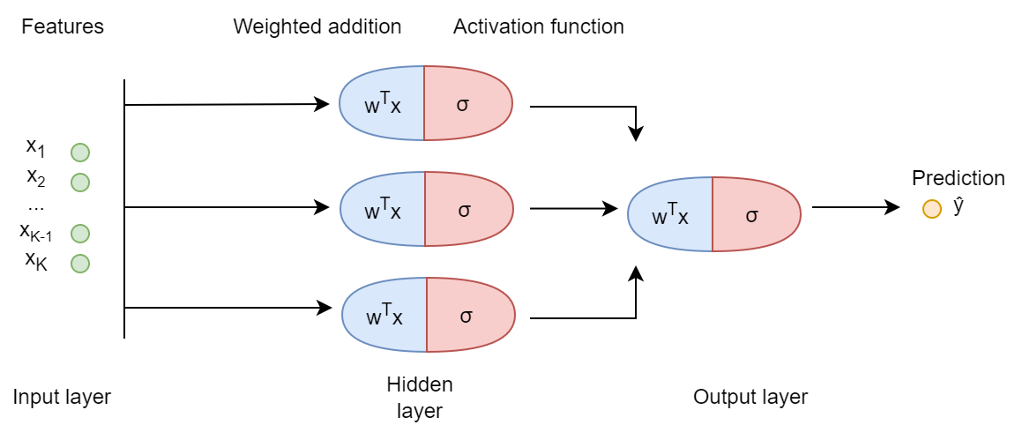
Language models
LM’s typically have sequences as input
So models must be built around this
Notes:
The models that we have seen so far do not take in sequences. They all use a bag-of-words approach, where all of the tokens in the context are treated just the same and their order is forgotten

Slide 17
Language models
Other NLP models/tasks with sequences as input:
Part-of-speech tagging
what kind of word is “is” in “the cat is on the mat”?
Named entity recognition
is “Anna’s” a named entity “the cat is on Anna’s mat”?
Sentence classification
does “the cat is sad” have negative sentiment?

Slide 18
Language models
Language models
Sequence models
Notes:
There are some language models that aren’t sequence models, like the ones that we have seen to far, but all state-of-the-art LMs take in sequential data, i.e. sentences in their right order. There are also sequence models that aren’t for language, for example models to predict the next note in a song, which can then be used to write music, or models that predict the next day’s weather given the previous days, to name just two.

Slide 19
RNNs
Or Recurrent Neural Networks

Slide 20
RNNs
Example: RNN for predicting the next token in a sentence
For a sentence “The cat is on the mat”
Predict “cat” given “the”
Predict “is” given “the” and “cat”
…
Predict “mat” given “the”, “cat”, “is”, “on”, “the”
Notes:
So, this is a language model´. Note that the exact task and the exact model architecture that I’m going to lay out are only one example of a sequence-based task and a RNN model. Later, I will give some more examples. So keep in mind that what we are about to see is not *the* RNN but *an* RNN, and this is only one way to set up a task for a language model.

Slide 21
RNNs
Example: RNN for predicting the next token in a sentence
For each sentence x^{<1>}, x^{<2>}, …, x^{<T-1>}, x^{<T>}
Predict x^{<2>} given x^{<1>}
Predict x^{<3>} given x^{<1>} and x^{<2>}
…
Predict x^{<T>} given x^{<1>} , x^{<2>}, …, x^{<T-1>}
Notes:
The triangular brackets you see are what we use to show the position in the sequence of some input x. Note that the x's here are typically vectors, not numbers. So they are list of numbers, in our case lists of numbers that represent which word is in this position in the sequence.

Slide 22
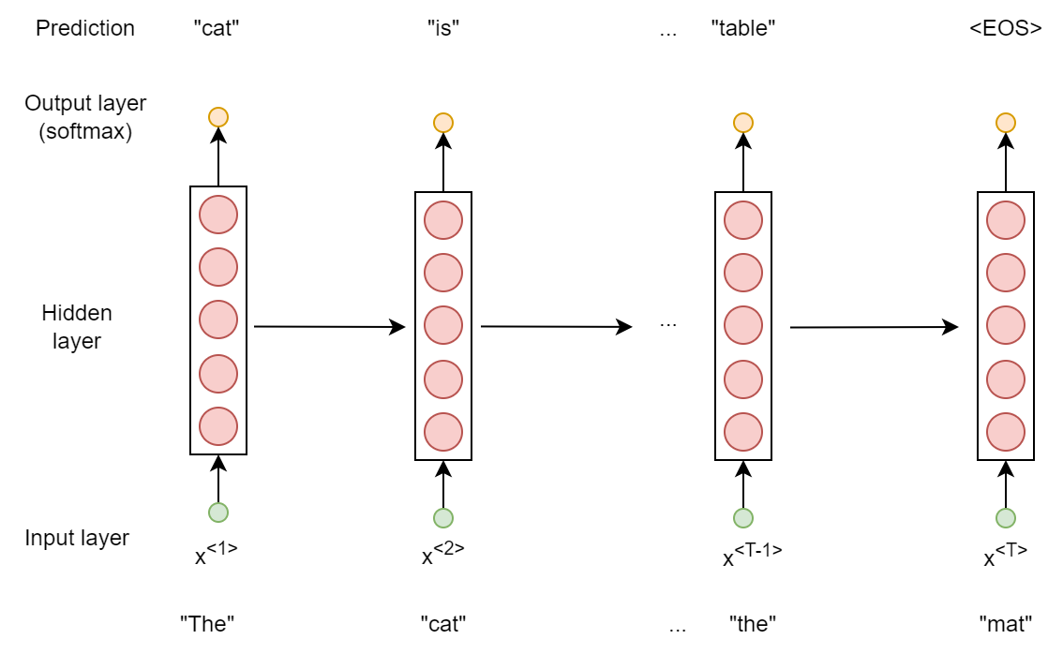
Notes:
Now, let’s look step by step at an RNN architecture that fits this task. We go through the sentence from left to right, and in each case we try to output a prediction for the next word. Here, the input is “The”. This gets fed into a hidden layer with some number of nodes, typically hundreds (which number, and what activation function they have, will vary from application to application). These nodes then get activated—perhaps one of the nodes will specialize in detecting that the input was an article like “the”, “a” or “an”. Next, the hidden layer nodes send their activation on to one output node. This is a softmax node: it takes many inputs and translates that into probabilities between 0 and 1 of many possible outputs. That's because we want to output the probability that the next word is any of the given words on our vocabulary. So the softmax layer outputs a vector that’s as long as our whole vocabulary, specifying how likely every single word is. At that point, we could pick the most likely word—for example, maybe the model got it right and the most likely word was “cat”.

Slide 23
Notes:
We keep going through the sentence from left to right, and in each case we try to output a prediction for the next word. What is key though, is that we feed the activation from each previous hidden layer into the next one. So if one of the nodes captured the fact that our first word was an article, then that information can actually be passed on to the hidden layer that is trying to predict the third position.

Slide 24
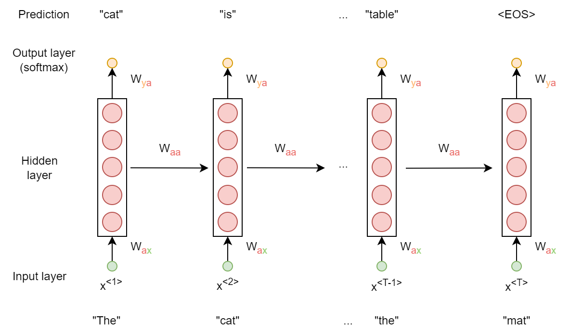
Notes:
Another key feature of the RNN is that the weights are shared across hidden layers (and across output nodes). So even though we drew the hidden layer many times in this figure, it’s actually the exact same layer with the exact same weights throughout. And same with the output node. So that means that, rather than having one hidden layer per position, each one having to learn on its own that “the” is an article and typically is followed by a noun, we actually have only one hidden layer that is learning from all positions in the sentence.

Slide 25
Notes:
This alternative, “rolled-up” notation of the RNN shows nicely how it is really just one hidden layer and one output node.

Slide 26
RNNs
Two key properties of an RNN:
Each hidden layer activation is fed into the next one
So the model can “remember” everything that came before
Weights are shared; hidden nodes (and output nodes) are all clones of each other
So the model does not need to learn hidden node weights from scratch for each position
Notes:
Note: hidden layer activation is also sometimes called "hidden state"

Slide 27
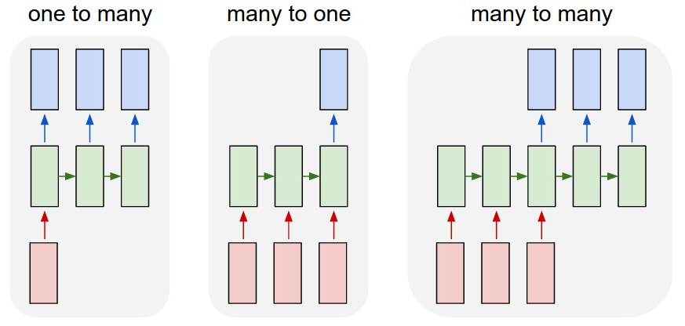
encoder
decoder
Input: “jazz”
Output: melody
Input: movie review
Output: sentiment
Input: English sentence
Output: French sentence
Input: question
Output: answer
Notes:
Many-to-many: this is an alternative form of a many-to-many architecture, where the input and output sequences may not be the same length. In the next word prediction example, this is not a problem. There are other tasks where the input and output sequences will be exactly the same length, like for example when we are trying to label each token by whether it’s a named entity or not. So the input might be “Harry is cool” and the output “1 0 0”. But when these inputs and outputs are not the same length, we need an alternative set-up, where one part of the RNN is taking in the input sequence but not outputting anything yet, so the final hidden layer activation state is supposed to contain all the relevant info in the sequence. The second part of the RNN then starts outputting the output sequence. This is also called an encoder-decoder architecture.
https://goodboychan.github.io/python/deep_learning/tensorflow-keras/2020/12/09/01-RNN-Many-to-many.html

Slide 28
LSTMs
Or long short-term memory models

Slide 29
LSTMs
RNNs are not good at long-term dependencies
Ex. “the cat with beautiful, luscious grey fur was on the mat”
Ex. “the cats with beautiful, luscious grey fur were on the mat”
Vanishing gradient problem:
x^{<2>} does not have a big impact on the gradient of ŷ^{<8>}
So it is difficult to learn weights that will lead from x^{<2>} to the right ŷ^{<8>}

Slide 30
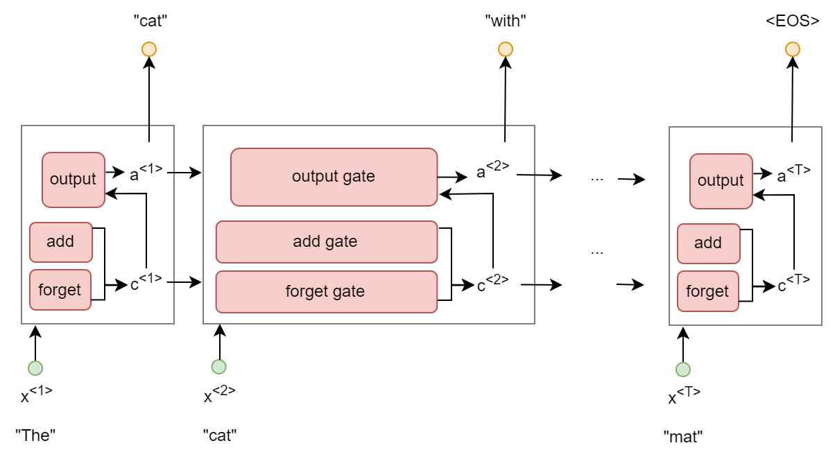
Notes:
Just like in the RNN, these cells are copies of each other, so we are not training different weight for each position in the sentence.

Slide 31
Notes:
Each LSTM cell has two states: one called c or context that represents everything we know about the sentence so far that could (still) be useful. And one called a or the activation output, which produces the actual output for that position (sometimes also named h for hidden state). These are vectors, so lists of possibly hundreds of numbers, and each place in the vector will take on a meaning of its own as we train the model. So one position in the activation vector might stand for whether the next verb we output should be singular or plural.

Slide 32
Notes:
Within each cell, three calculations happen. First, a forget gate looks at what’s currently incoming—both the previous cell’s activation output a and the latest input x—and on the basis of that, decides what should be forgotten about the context c. So for example, we might learn that the previous cell outputted a noun, and so we might want to forget the fact that the sentence started with an article (“the”) because that article has now been matched with a noun, so we can forget about that.

Slide 33
Notes:
Second, an add gate also looks at what’s currently incoming (a and x) and decides what should be added to the context. For example, we might learn that the current input is “cat”, so we want to add some value to the places in the context vector that record that the sentence is about animals. The add and forget gate combined result in a new context vector, where irrelevant info has been forgotten and relevant new info has been added.

Slide 34
Notes:
Finally, an output gate takes in this new context vector, as well as (once again) all the new incoming info: the previous activation output a and the current input x. It translates those into a new output activation a, which in turn produces the cell’s output—in this case, probabilities for what the next word in the sentence is. For example, later in the sentence we might see the input “grey” and have access to the context info that this sentence is about animals, so we might output a high probability for the next word being “fur”.

Slide 35
Notes:
Summing up, LSTM consists of copies of the same cell, which has three gates. All of them take in the current input and the previous activation. The forget and add gates use this new info to decide what should be dropped and added from the context vector—this is the long-term memory of the LSTM. The output gate use this new info, together with the context, to decide what we should be outputting right now.

Slide 36
Variants of RNNs

Slide 37
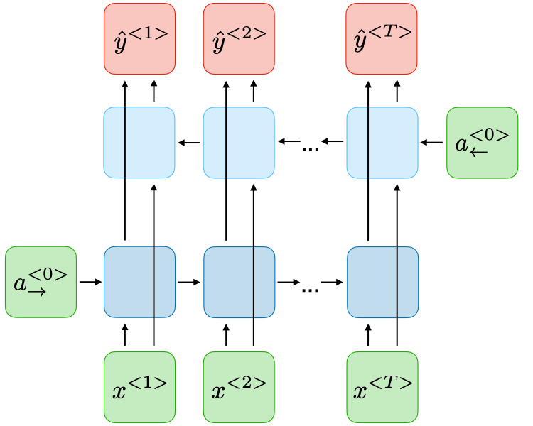
Notes:
Bidirectional RNN
https://stanford.edu/~shervine/teaching/cs-230/cheatsheet-recurrent-neural-networks

Slide 38
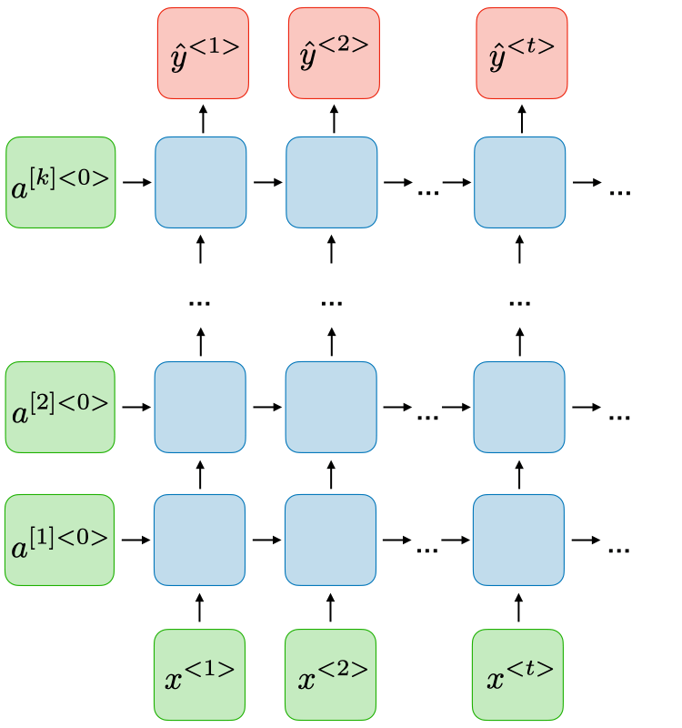
Notes:
Deep RNN
https://stanford.edu/~shervine/teaching/cs-230/cheatsheet-recurrent-neural-networks

Slide 39
Next class preview

Slide 40
Attention and transformers: content
Attention
Transformers
BERT
GPT
Large language model caveats

Slide 41
Attention and transformers: readings
Short sections from Hovy
Long video on transformers
Medium-long video on BERT
Stochastic parrots 🦜 (Bender et al.)

